Slide 1
Probability
March 26th, 2023

Slide 2
Today
Why do we need “Probability”
Computing Probabilities
Sample Space, Event space
The addition rule
The product Rule
Counting techniques
Probability distributions
Joint, Marginal, and Conditional Probabilities
Sampling Methods

Slide 3
Question
How long does it take you to reach your college/office from home/hostel?
Because the time taken may vary from day-to-day, depending on many other factors, on any given day, we are uncertain about the exact time it would take.
Such variables are termed Random Variables
However, you are still able to answer that question with a single number, as in your mind you have an idea of an average time, or expected time to reach your college
You have implicitly used the basic concepts of Statistics, to answer that question

Slide 4
An example of a Machine Learning Problem
Identifying SPAM Mails
E-Mail | Suspicious Words | Unknown Sender | Spam
1 | Y | Y | Y
2 | N | Y | N
3 | Y | N | Y
4 | Y | N | N
5 | N | Y | Y
6 | Y | N | Y
7 | Y | N | Y
8 | Y | N | N
9 | N | Y | N
10 | Y | N | Y
E-Mail | Suspicious Words | Unknown Sender | Spam
1 | Y | Y | Y
2 | N | Y | N
3 | Y | N | Y
4 | Y | N | N
5 | N | Y | Y
6 | Y | N | Y
7 | Y | N | Y
8 | Y | N | N
9 | N | Y | N
10 | Y | N | Y
E-Mail | Suspicious Words | Unknown Sender | Spam
1 | Y | Y | Y
2 | N | Y | N
3 | Y | N | Y
4 | Y | N | N
5 | N | Y | Y
6 | Y | N | Y
7 | Y | N | Y
8 | Y | N | N
9 | N | Y | N
10 | Y | N | Y
Suspicious Words | Unknown Sender | Spam
Y | Y | ?
Suspicious Words | Unknown Sender | Spam
Y | N | ?
A new Mail Arrives
66.7% chance – Yes
33.3% chance - No

Slide 5
Why Probability and Statistics?
Remember the equation: v = u + at
If you know initial conditions: Value of u, and a, you can compute v for any given time t.
It doesn’t matter who does the computing, at what time of day, or in which country, the answer would be the same.
The variable, v is not affected by any random fluctuations
Such systems are called deterministic systems.
Systems which are affected by random fluctuations, are called Stochastic systems.
The time taken to reach college/office varies everyday is one such variable
Statistics and Probability is the science of dealing with uncertain data
The theory and methods of probability, enable us to treat “Uncertainty” in a mathematical framework

Slide 6
Probability

Slide 7
Back to School
An urn contains 12 red dice and 18 blue dice. If you are asked to draw 6 dice from the urn randomly, What is the probability that you will draw 3 red dice?
You land up at this old school meeting where there are 50 people including you. What is the probability that at least two of you share the same birthday?
If you toss a fair coin 50 times, what is the probability that you will get 30 heads?

Slide 8

Why do we talk about coin tosses ,cards and dice in Probability
Passes a quality test/Fails a quality test
Gender: Man/Women
Customer: Buys/Doesn’t buy
Education Level of an employee (many levels)
Colour of mobile phones (Many colours)
Brand of car (Many options)
Number of durables owned
Number of children at home
Number of promotions a employee is given

Slide 9
Randomness
In many situations one will know what are all the possible outcomes, but one cannot be certain about the exact outcome
e.g. You Buy a Lottery ticket
You may win, or may not win – Possibilities are fixed, known
Will you win, or not win – Exact outcome is uncertain
e.g. You roll a dice
You my get 1,2,3,4,5, or 6 - Possibilities are fixed, known
Will you get 1,2,3,4,5, or 6 - Exact outcome is uncertain
Both the examples above has an element of randomness that governs the outcome at any instance

Slide 10
Quantifying Randomness
Lets take the example of rolling the dice again
If two people experiment (with 10 trials) to understand what is the proportion of the outcome being “6”, we may get something like this..
Roll (Trial) | Your Roll |  | Cumulative Proportion of 6's | My roll |  | Cumulative Proportion of 6's
1 | 6 |  | 1/1 | 1 |  | 0/1
2 | 5 |  | 1/2 | 2 |  | 0/2
3 | 1 |  | 1/3 | 1 |  | 0/3
4 | 6 |  | 2/4 | 1 |  | 0/4
5 | 6 |  | 3/5 | 3 |  | 0/5
6 | 2 |  | 3/6 | 2 |  | 0/6
7 | 3 |  | 3/7 | 4 |  | 0/7
8 | 1 |  | 3/8 | 5 |  | 0/8
9 | 4 |  | 3/9 | 3 |  | 0/9
10 | 4 |  | 3/10 | 6 |  | 1/10
You may have vastly different predictions with small number of trials – Expected of a random phenomenon
At the end of 250 trials, proportion of 6’s – 50/250, and at the end of 1000 trials – 170/1000

Slide 11
Quantifying Randomness - Probability
If the number of trials are large (or as they say “In the Long Run”),the proportion of 6’s will be closer to 1/6.
We are able to put a number of to the outcome.
Probability – The probability of a particular outcome is the proportion of times that particular outcome would occur in a long run of observations

Slide 12
Experiments and Outcomes
Let us say, we toss a coin three times:
Why? – We may like to ascertain whether the coin is fair
A quality control unit decides to sample “n” products out of “N” produced and classifies each of the n products as “Quality Passed”, or Quality Failed”
The above are examples of “Experiments”, or Sample Studies”
What are the different possible results when we toss a coin three times?
Toss 1 | Heads |  |  |  | Tails
Toss 2 | Heads |  | Tails |  | Heads |  | Tails
Toss 3 | Heads | Tails | Heads | Tails | Heads | Tails | Heads | Tails
Summary Result | HHH | HHT | HTH | HTT | THH | THT | TTH | TTT
Each possible result of the experiment is called an “Outcome”

Slide 13
Sample Space and Events
Sample Space is the set of all possible outcomes in a random phenomenon
e.g. Let us say, we toss a coin three times:
The sample space is: {HHH, HHT,HTT,HTH,THH,THT, TTH,TTT}
An Event is a subset of the sample space and some examples are:
Event A: The first toss is Heads: {HHH, HHT,HTT,HTH}
Event B: There at least two heads in three tosses: {HHH, HHT, HTH,THH}
Event C: The first toss is tails: {THH, THT, TTH, TTT}
Q: If Event D is defined as “ No two successive outcome is the same”, How many outcomes will be there in the event space, and what are those outcomes?

Slide 14
Probabilities for an Event
The Probability of each individual outcome is between 0 and 1
0 ≤ P(HHH) ≤ $1, and so on$
The total of all individual outcome probabilities equals 1.
The Probability of event A, is
$P(A)=\frac{Number of outcomes in event A}{Number of outcomes in the sample space}$
If, Event A: The first toss is Heads: {HHH, HHT,HTT,HTH}
Sample space is: {HHH, HHT,HTT,HTH,THH,THT, TTH,TTT}
P(First toss is Heads) = 4/8 = 0.50
Probability (Event D) = 2/8 = 0.25

Slide 15
Computing Probabilities - Difficulties
We looked at example of tossing the coin three times, and we could easily count the eight outcomes. Supposing we toss the coin Six times, we will have a total of 2⁶ outcomes = 64 – Gets Difficult, isn’t it?
So, lets look at some easier rules, and methods to compute the probabilities
By identifying events of different types
Revisiting some old school mathematics for some useful counting techniques

Slide 16
Independent Events
Independent Events
Two events are independent if occurrence of one has no influence on occurrence of other Example: In a three coin toss experiment, the occurrence of head in second and third tosses is independent of occurrence of head or tail in first or second toss
Example of dependent events:
Two card players are dealt two cards each by turn. You receive the first card, and it is a spade. (Probability: 13/52). The other player gets his first card. Then you get your second card: What is the probability that the second card you received is also spade ???
Notes:
Notes for Nandan:
Sales/Marketing: Choose a set of people to get satisfaction survey or choose a set of people to promote something to find out if it is an attractive feature
Credit: We need details on the credit demographic of different types of car purchasers. Take a sample and ask a credit rating agency
Operations: We have a rich data set of people of how long people spend in our showrooms and whether they purchased a product or not. Take a random sample to help capacity planning.

Slide 17
Independent Events – Product Rule
Two events are independent, if occurrence of one event does not influence the occurrence of the other event
e.g. Suppose we want to know the probability of event {HHT}, in a three coin toss..
First Event = P(Heads in the first toss) = ½
Second Event = P(Heads in the second toss) = ½
Third Event = P ( Tails in the third toss) = ½
The outcome of the first event does not affect the outcome of the second event, and so forth.
Therefore, P(HHH) = ½ * ½ * ½ = 1/8
i.e. $P\left(A∩B∩C\right)=P\left(A\right)×P(B)$ x P(C) – Is the Product rule for independent events
For two dependent events A and B,
P(A and B) = P($A∩B$) = $P\left(B\right)$X $P(A|B)$

Slide 18
Mutually Exclusive Events
Mutually Exclusive Events
Two events are mutually exclusive if occurrence of one prevents the occurrence of the other Example: In a three coin toss experiment, events {The first toss is Heads} and {The first toss is tails} are mutually exclusive If there are no common outcomes between two event sets, then they are mutually exclusive events
Notes:
Notes for Nandan:
Sales/Marketing: Choose a set of people to get satisfaction survey or choose a set of people to promote something to find out if it is an attractive feature
Credit: We need details on the credit demographic of different types of car purchasers. Take a sample and ask a credit rating agency
Operations: We have a rich data set of people of how long people spend in our showrooms and whether they purchased a product or not. Take a random sample to help capacity planning.

Slide 19
Mutually Exclusive Events – Addition Rule
Mutually Exclusive events are events which do not have any common outcomes:
Say, in a three coin toss,
Event A = {First toss is heads}
Event B = {First Toss is Tails}
Event A = {HHH, HHT, HTH, HTT}, P(A) = 4/8
Event B = {THH,THT, TTH, TTT}, P(B) = 4/8
If we define a new event C, as either Event A or Event B,
P(C) = P(A or B) = P(A)+P(B) = 4/8+4/8 = 1
i.e. $P\left(A∪B\right)=P\left(A\right)+P(B)$ – is the sum rule for mutually exclusive events

Slide 20
Mutually non-exclusive events – Addition Rule
Mutually Non-Exclusive events are events that do have some common outcomes:
Say, in a three coin toss,
Event A = {First toss is heads, and there are at least two heads in total}
Event B = {First Toss is Heads, and the last is not tails}
Event A = {HHH, HHT, HTH}, P(A) = 3/8
Event B = {HHH, HTH}, P(B) = 2/8
If we define a new event C, as either Event A or Event B
P(C) = {P(A or B) = P(A)+P(B) – Outcomes that are double counted}
= 3/8+2/8 -2/8 = 3/8
i.e.$P\left(A∪B\right)=P\left(A\right)+P\left(B\right)−$ $P\left(A∩B\right)$
– is the sum rule for mutually non-exclusive events

Slide 21
Useful Counting Techniques
Most of the computations of probability involves “Counting”
In a restaurant, there is an option of “a” number of (say 6) dishes, and b number of (say 5) beverages, and you could pick one of each. How many different choices are available to you?
Ans: 6x5 = 30
If you are given “n” (say 4) different alphabets, and are asked to form “r” (say 3) letter PIN codes, (You can reuse an alphabet), how many codes can be generated?
Ans: 4x4x4 = 64 = n^{r}

Slide 22
Useful Counting Techniques
If you are given “n” (say 4) different alphabets, and are asked to form “r” (say 4) letter PIN codes, (You can use each alphabet only once), how many codes can be generated?
Ans: 4x3x2x1 = 24 = n x (n-1) x (n-2) x …..x 2 x1 = n!
Total number of ordered sequences for “n” distinguishable objects is n!
If you are given four different alphabets, and are asked to form two letter PIN codes, (You can use each alphabet only once), how many codes can be generated?
Ans: 4x3 = 12 = $\frac{4∗3∗2∗1}{2∗1}$ = $\frac{n!}{\left(n−r\right)!}$
In both the problems above the order in which the alphabets appear is important. (i.e. “ab”, and “ba” are two different PIN codes)

Slide 23
Useful Counting Techniques
Consider this problem: there are “n” (say 4) teams in a tournament (A,B,C,D), and each team plays the other once (i.e. “r” =2). How many matches are there in total?
(A,B), (A,C), (A,D), (B,C),(B,D), (C,D) – Six in total
Y$ou can show this to be equal to \frac{n!}{r!\left(n−r\right)!}$
The term above is referred to as Binomial coefficient and is notated as $\left({n \atop r}\right)$

Slide 24
Computing probabilities using Rules and techniques
An urn contains 12 red dice and 18 blue dice. If you are asked to draw 6 dice from the urn randomly, What is the probability that you will draw 3 red dice?
Problems of this type are called the “urn” model problems.
Total number of ways you can draw 6 dice from a total of 30 dice is $\left({30 \atop 6}\right)$
Total number of ways you can draw 3 red dice from a total of 12 red dice is $\left({12 \atop 3}\right)$
Total number of ways you can draw 3 Blue dice from a total of 18 Blue dice is $\left({18 \atop 3}\right)$
Probability of (3 R, From 12 R and 18 B, given n= 6) = $\frac{\left({12 \atop 3}\right)\left({18 \atop 3}\right)}{\left({30 \atop 6}\right)}$ = 0.302

Slide 25
Same Birthday Problem – Using Rules and Techniques
You land up at this old school meeting where there are 50 people including you. What is the probability that at least two of you share the same birthday?
Standard Approach – by counting
Probability of at least two of the students having the same birthday = 1 – (Probability of no one having the same birthday)
Probability of no one having the same birthday = $\frac{count of all possibilities where no one has the same birthday (Event Space)}{Count of all possibilities (Sampe Space)}$
Count of all possibilities (sample Space)
Student | 1 | 2 | 3 | ……… | ………… | ………… | 49 | 50
Possible days of birth | 365 | 365 | 365 | 365 | 365 | 365 | 365 | 365
Probability that at least two share a birthday = 0.97
Total number of possibilities = 365⁵⁰
$$count of all possibilities where no one has the same birthday (Event Space)$$
Student | 1 | 2 | 3 | ……… | ………… | ………… | 49 | 50
Possible days of birth | 365 | 364 | 363 |  |  |  | 317 | 316
Total number of possibilities = 365*364*363*……..*317*316

Slide 26
Probability Distributions

Slide 27
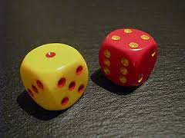
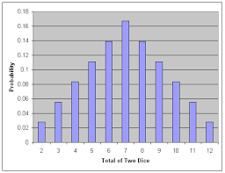
Probability Distribution Functions – By Example
Throwing two dice together
Each die can turn up with any one of 6 values {1,2,3,4,5,6}. For two dice, there are a total of 6x6 = 36 combinations {Sample Space}
The sum of the two die values cannot be 0, or 1, and also cannot be greater than 12
We can get a sum of 2, through only one combination: {1,1}. Hence probability of sum = 2, is 1/36
We can get a sum of 6, through the following combinations: {1,5}, {5,1}, {2,4}, {4,2}, {3,3}.Hence probability of sum = 6, is 5/36
Sum | 2 | 3 | 4 | 5 | 6 | 7 | 8 | 9 | 10 | 11 | 12 | Total
Probability | 1/36 | 2/36 | 3/36 | 4/36 | 5/36 | 6/36 | 5/36 | 4/36 | 3/36 | 2/36 | 1/36 | 1
A plot of the probabilities, is called the probability distribution function
For discrete random variables such plot , is called the probability mass function (pmf)
For continuous random variables such plot , is called the probability density function (pdf)
You can describe such functions as appropriate mathematical equations

Slide 28
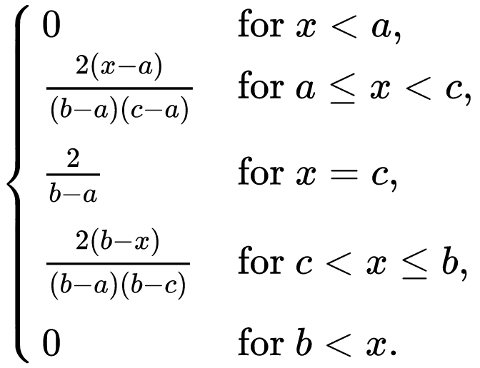



Computing Probabilities from distributions
For Probability Mass Functions – for discrete variables
$$p(x=c)=\frac{2}{(b−a)}$$
-----------------------------
Probability
500 simulated rolls
a = 1
c = 7
b = 13
$p(x=7)=\frac{2}{(13−1)}$ = $\frac{1}{6}$ = $\frac{6}{36}$
Outcomes
$p(x=5)=\frac{2(x−a)}{(b−a)(c−a)}$ = $\frac{2(5−1)}{(13−1)(7−1)}$ = $\frac{8}{(12)(6)}$ = $\frac{4}{36}$
Sum | 5 | 7 | 10
Probability | 4/36 | 6/36 | 3/36
$p(x=10)=\frac{2(b−x)}{(b−a)(b−c)}$ = $\frac{2(13−10)}{(13−1)(13−7)}$ = $\frac{6}{(12)(6)}$ = $\frac{3}{36}$

Slide 29
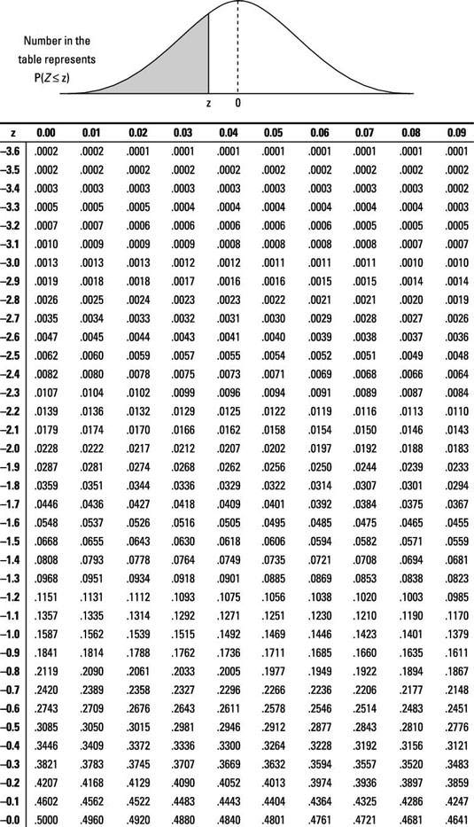
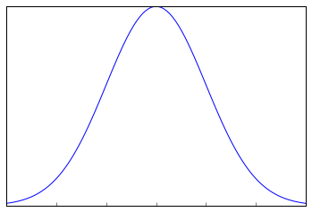
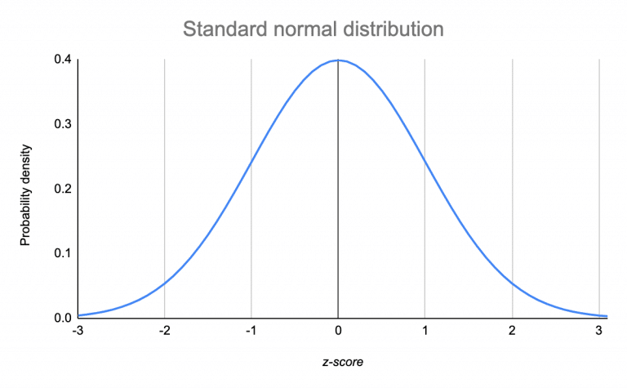
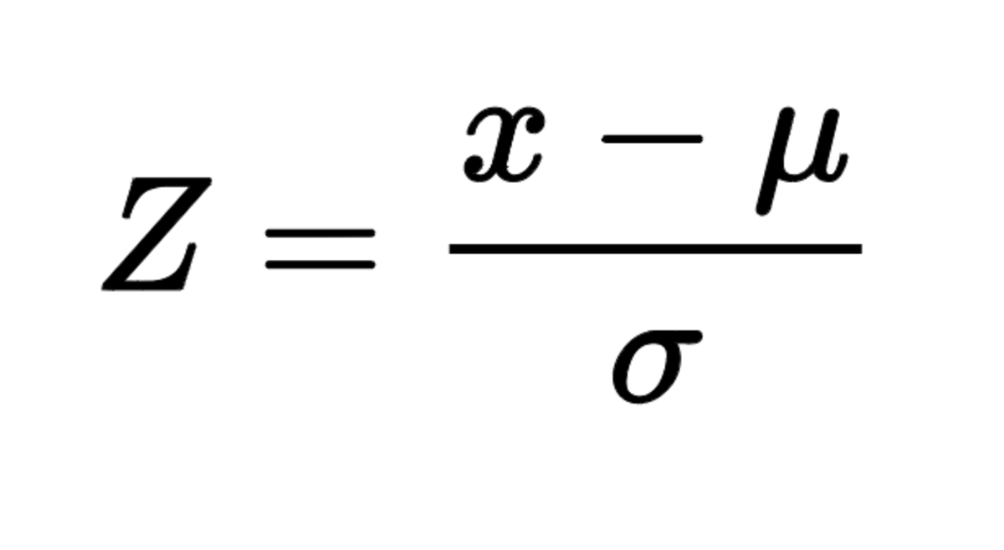



Computing Probabilities from distributions
For Probability Density Functions – for continuous variables
Probability Density
$z\text{a}\text{=}$ = $\frac{a−µ}{σ}$
$z\text{b}\text{=}$ = $\frac{b−µ}{σ}$
a
b
b
Outcomes
a
The area under the curve defines the probability

Slide 30
Expected Value
Let us assume a roulette wheel has 38 slots, and you are betting on one of the numbers where the roulette ball will settle down finally. If you bet one unit of currency, and choose a number and If the ball actually lands in the number you have chosen you win 30 units of currency, otherwise you loose your one unit of currency.
Assuming the roulette board is fair, what is the expected value of your bet?
Since there are 38 slots, each slot has a chance of 1/38, to receive the ball finally
So, your win probability is 1/38, and lose probability is 37/38
Expected value is calculated as (30*1/38) + (-1 * 37/38) = (30/38) – (37/38) = -7/38
Expected value is the weighted average of all possible values the event can take, weighted by the probability of occurrence of each event

Slide 31
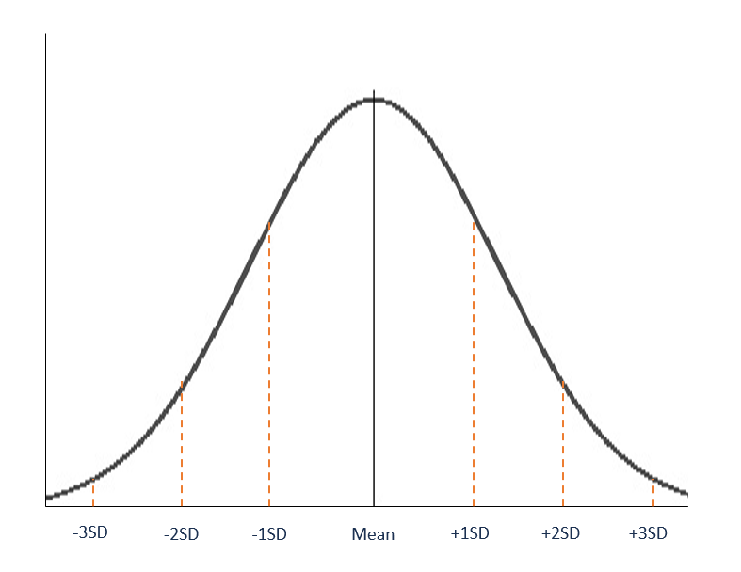
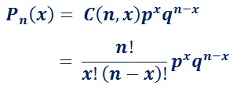
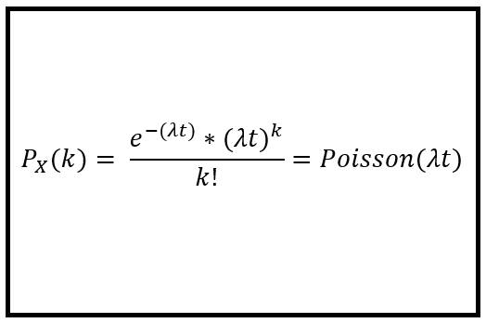
Commonly encountered distribution functions
Normal Distribution
Parameters: μ,σ
Describe Events that has
Continuous outcomes
Binomial Distribution
Describe Discrete Events that has
Two Outcomes
Trials are independent
Parameters: n,p
Poisson Distribution
Parameters: λ
Describe Discrete Events that occur at some rate over time

Slide 32
Binomial Distribution
If you toss a fair coin 50 times, what is the probability that you will get 30 heads?
The Binomial model is appropriate, when you have a sequence of independent trials, and each trial has only two outcomes
Binomial Distribution
For the following values:
n = 50
p = 0.5
q= 0.5
x = 30
You can compute the Probability (30 Heads, in a 50 tosses) = 0.042 (or 4.2%)

Slide 33
Use of Poisson Distribution - Example
YEAR | 1 | 2 | 3 | 4 | Average # Purchases/Year
Customer 1: No of Purchases | 3 | 4 | 2 | 3 | 3
3 is the average # of purchases that the customer makes in a year. The actual number of purchases in a given year can be anywhere from 0 to ∞
If the purchase process follows a Poisson distribution, the probability of X = k purchases is given by the formula
Where,
λ = Average Rate = 3
k = No of Likely Purchases 1,2,3…
t = Time period
Average # of Purchases λ | 3
# of Purchases k | Probability (X =k)
0 | 0.05
1 | 0.15
2 | 0.22
3 | 0.22
4 | 0.17
5 | 0.10
6 | 0.05
7 | 0.02
8 | 0.01
9 | 0.00
Though we do not know exactly the number of purchasers a specific customer would make, we know the probability of his making 1 purchase, 2 purchases etc….

Slide 34
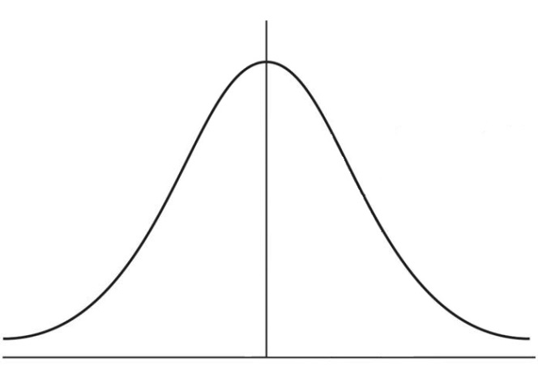
Use of Normal Distribution - Example
A company monitored their monthly transportation cost over a long period of time and found it to be approximately normally distributed with a mean value of ₹ 4,00,000/- with a standard deviation of ₹ 20,000.
If they have budgeted ₹ 4,40,000/- for the next month, what is the probability that the actual costs will exceed the budgeted amount?
μ = ₹ 4,00,000
σ = ₹ 20,000
Area
x = ₹ 4,40,000
You can compute the probability as 0.0228 (2.28%)

Slide 35
Probability Joint, Marginal, and Conditional

Slide 36
Marginal & Joint Probabilities
Days of | Rains | No Rains | Total
Thick Clouds | 24 | 6 | 30
Light Clouds | 21 | 49 | 70
Total | 45 | 55 | 100
Out of 100 days – 30 days had Thick Clouds : P(Thick Clouds) = 0.30
Out of 100 days – 70 days had Light Clouds: P(Light Clouds) = 0.70
Out of 100 days – 45 days had rains: P(Rains) = 0.45
Out of 100 days – 55 days had Rains: P(No Rains) = 0.55
All of these are
Marginal Probabilities
Days of | Rains | No Rains | Total
Thick Clouds | 0.24 | 0.06 | 0.3
Light Clouds | 0.21 | 0.49 | 0.7
Total | 0.45 | 0.55 | 1
Out of 100 days – 24 days had Thick clouds and Rains
i.e. P(Thick Clouds ∩ Rains) = 0.24
P(Light Clouds ∩ Rains) = 0.21
P(Thick Clouds ∩ No Rains) = 0.06
P(Light Clouds ∩ No Rains) = 0.49
All of these are
Joint Probabilities

Slide 37
Conditional Probabilities
Days of | Rains | No Rains | Total
Thick Clouds | 24 | 6 | 30
 | 0.8 | 0.2 | 1
Light Clouds | 21 | 49 | 70
 | 0.3 | 0.7 | 1
Total | 45 | 55 | 100
On the 30 days we had Thick Clouds – It Rained on 24 days
P(Rains, If we had thick clouds) = 0.8
P(Rains|Thick Clouds) = 0.8
P(No Rains|Thick Clouds) = 0.2
All of these are
Conditional Probabilities
P(Rains|Light Clouds) = 0.3
P(No Rains|Light Clouds) = 0.7
Days of | Rains | No Rains | Total
Thick Clouds | 24 | 6 | 30
 | 0.53 | 0.11
Light Clouds | 21 | 49 | 70
 | 0.47 | 0.89
Total | 45 | 55 | 100
 | 1 | 1
P(Thick Clouds|Rains) = 0.53
P(Rains|Thick Clouds) = 0.8
P(Thick Clouds|Rains) = 0.53
Notice that we had 24 days in which we had both Thick clouds and Rains
The same number is expressed as a proportion two different bases.
Is it possible that these probabilities can be linked through some mathematical expression?

Slide 38
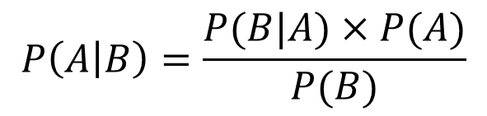

Bayes Theorem
Days of | Rains | No Rains | Total
Thick Clouds | 0.24 | 0.06 | 0.3
Light Clouds | 0.21 | 0.49 | 0.7
Total | 0.45 | 0.55 | 1
Days of | Rains | No Rains | Total
Thick Clouds | 0.24 | 0.06 | 0.3
Light Clouds | 0.21 | 0.49 | 0.7
Total | 0.45 | 0.55 | 1
0.8
0.2
1.0
0.53
0.47
1.0
P(Thick Clouds) = 0.30
P(Thick Clouds ∩ Rains) = 0.24
P(Rains) = 0.45
P(Rains ∩ Thick Clouds) = 0.24
P(Rains|Thick Clouds) = $\frac{\text{P}\text{(}\text{Thick} \text{Clouds} \text{∩} \text{Rains}\text{)}}{\text{P}\text{(}\text{Thick} \text{Clouds}\text{)}}$ = 0.8
P(Thick Clouds|Rains) = $\frac{\text{P}\text{(}\text{Rains}\text{∩} \text{Thick} \text{Clouds}\text{)}}{\text{P}\text{(}\text{Rains}\text{)}}$ = 0.53
We can re-write the above equation as:
P(Thick Clouds ∩ Rains) = P(Rains|Thick Clouds) * P(Thick Clouds)
We can re-write the above equation as:
P(Rains∩ Thick Clouds) = P(Thick Clouds|Rains) * P(Rains)
∴ P(Rains|Thick Clouds) * P(Thick Clouds) = P(Thick Clouds|Rains) * P(Rains)
$P\left(B\right)$X $P\left(A | B\right)= P\left(A\right) \text{X} P(B|A)$
$$P\left(A | B\right)=\frac{P(B|A)×P(A)}{P(B)}$$
Bayes theorem

Slide 39
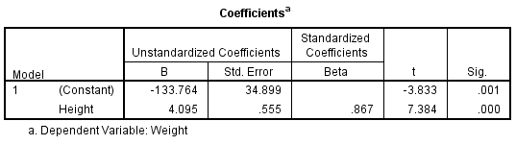
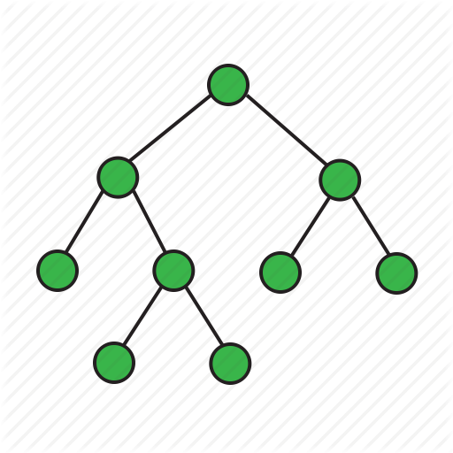
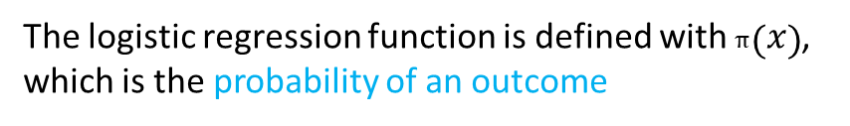
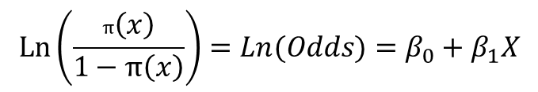
Use of Theory of probability in data science – More Examples
Regression
Inferential statistics, for which the backbone is the probability theory
Logistic Regression
$$\operatorname{Ln}\left(\frac{π\left(x\right)}{1−π\left(x\right)}\right)=Ln(Odds)=β_{0}+β_{1}X$$
The logistic regression function is defined with $π\left(x\right)$, which is the probability of an outcome
Decision Trees and Random Forest
Efficient construction of trees and forest is achieved by using measures such as: Entropy, Information Gain, and Gini Index all of which are probability measures.

Slide 40
Use of Theory of probability in data science – More Examples
Customer Life Time Value (LTV) – The BG/NBD - Model
The model Considers the following:
The number of purchases in a given time
The model assumes that while alive, each customer purchases according to a Poisson probability process with parameter λ (purchase rate)
The parameter λ is different across customers, and the model assumes that heterogeneity in that process is captured by a gamma probability distribution, with parameters r, and α
Will a customer remain alive? (i.e. will he stay with us as a customer?)
Each Customer’s lifetime is assumed to follow a geometric probability distribution, with a parameter p (Probability of a customer becoming inactive after a transaction)
The average monetary value z of each customer is estimated using the Gamma – Gamma probability Model

Slide 41
Population and Sample

Slide 42
Population and Sample
Population:
Refers to the whole group or set of data points on which inferences or predictions are to be made
Size of the population could be very large depending on the inference to be made
Battery life example: Population is the set of all mobiles of that particular model
OTT example: Population is the set of all people in India who watch movies on OTT platforms
Sample:
A set of data points which are representative of the population
Size of sample set is generally much smaller than the size of population

Slide 43
Obtaining Sample from Population
Population dataset
Sampling is performed to get a sample set from the actual population
3 types of Sampling:
Random sampling: Each data point of population is picked with equal probability
1
2
3
4
5
6
7
8
9
10
11
12
13
14
15
16
17
18
19
20
21
22
23
24
1
5
Randomly
Sampled
dataset
6
10
16
21

Slide 44
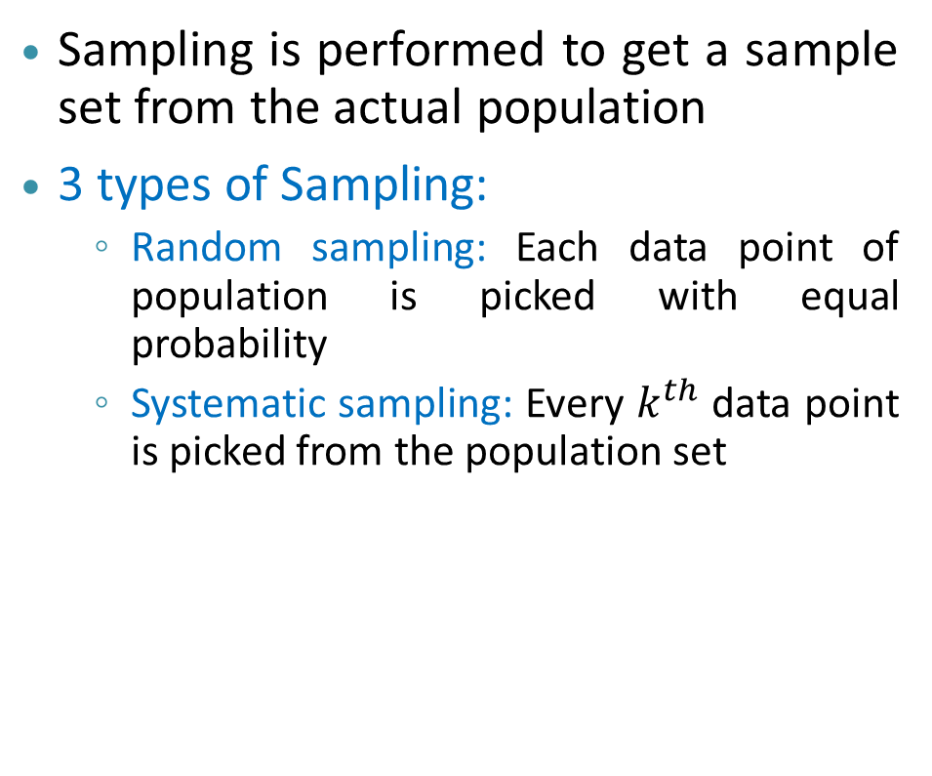
Obtaining Sample from Population
Population dataset
Sampling is performed to get a sample set from the actual population
3 types of Sampling:
Random sampling: Each data point of population is picked with equal probability
Systematic sampling: Every $k^{th}$ data point is picked from the population set
1
2
3
4
5
6
7
8
9
10
11
12
13
14
15
16
17
18
19
20
21
22
23
24
1
5
Systematically
Sampled
dataset
9
13
17
21

Slide 45
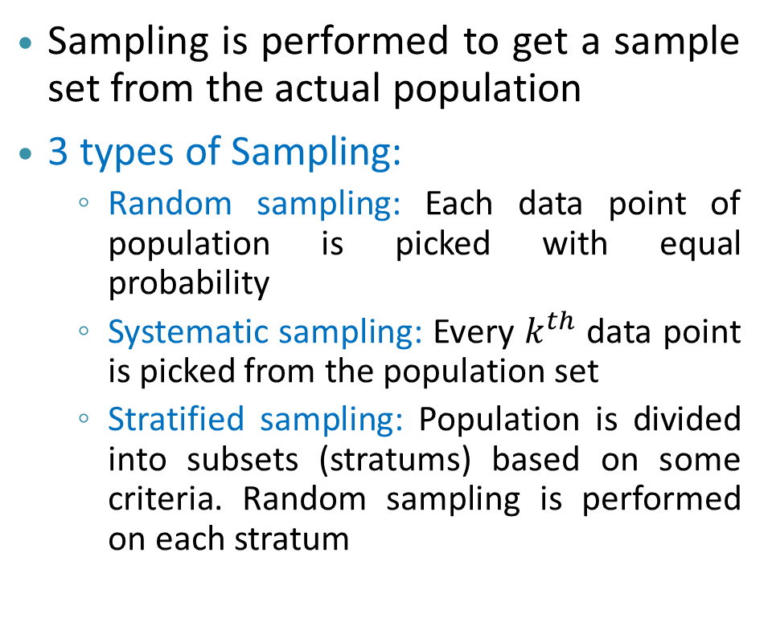
Obtaining Sample from Population
Stratified Population dataset
Sampling is performed to get a sample set from the actual population
3 types of Sampling:
Random sampling: Each data point of population is picked with equal probability
Systematic sampling: Every $k^{th}$ data point is picked from the population set
Stratified sampling: Population is divided into subsets (stratums) based on some criteria. Random sampling is performed on each stratum
1
2
3
4
5
6
7
8
9
10
11
12
13
14
15
16
17
18
19
20
21
22
23
24
1
14
Stratified
Sampled
dataset
7
18
11
23

Slide 46


Use of Sampling in Data Analytics
Situation $1$
Cost of collecting the data for the entire population would be prohibitive
It would also be logistically difficult and time consuming.
We will collect only part of the data
In cases where the entire data is automatically collected and available.
However for model development, we wish to consider only a part of the data
e.g. Bank transactions – which may be too bulky, and hence unviable.
Situation $2$
Situation 3
Most analytics algorithms requires that the data be partitioned as Training data (to develop the model), and Test data (to validate the model)

Slide 47
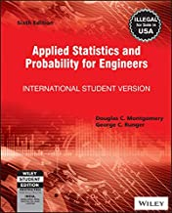
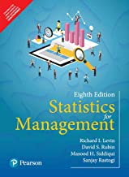


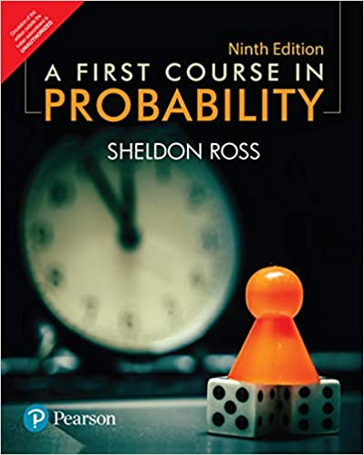
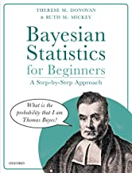
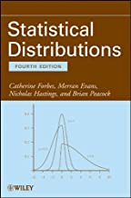
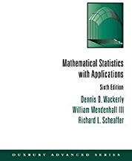
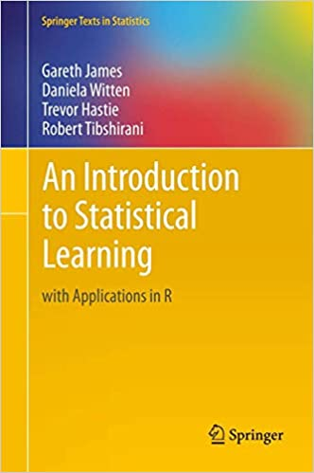
Suggestions on Books – Probability and Statistics
Introductory, easy to follow, lots of examples
Gentle Read
Expensive - Interesting
Thorough
Expensive – Gentle Introduction
Very Expensive –
Nice mathematical treatment with plenty of examples Look for Used Books stores
Application Oriented
Worth owning,
{Older edition is very affordable}
Also available as free pdf download
Expensive – Older edition should do

Slide 48
The End

